Slide 1
Introduction to Python Python хэлний үндэс
Py4Econ
UB, 2021

Slide 2
About the course
Basics of Python and programming know-hows
Elementary to Intermediate
Python topics covered: data structures, control flow, functions, modules, classes, files, regex, automation, data visualization, web scraping
Python topics not covered: data analysis, web development, ML & AI
Final projects:
Excel manipulation
Data cleaning and visualization
Web scraping & sending automated email

Slide 3
Week 1: Learning objectives
Overview of Python
Computer basics
Communities
Folder structures, Path, Shell
Python / Anaconda
Text editor, notebook, IDE
Git & Github
Coding best practice

Slide 4
Background

Slide 5
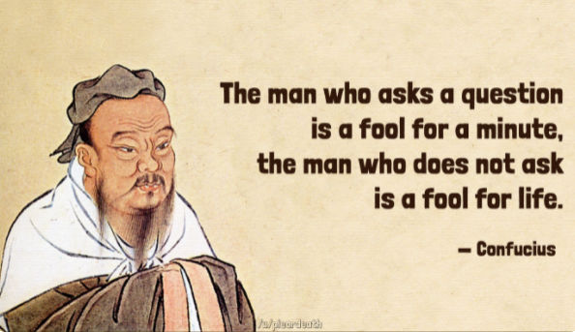

Slide 6
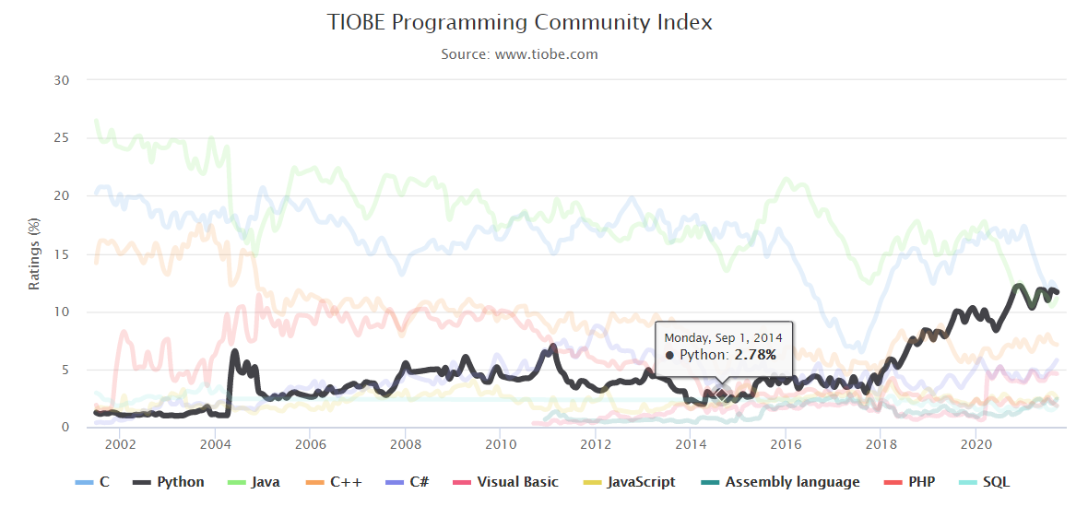
Why Python?
+
Beginner friendly
Notes:
https://medium.com/@devathon_/top-10-best-programming-language-rankings-e49a0def796c

Slide 7
Popular applications of Python
Scientific computing (incl. Financial modelling)
Data science & Data visualization
Machine learning & AI
Web & Game development
Applications & Software & GUI
Automation
…

Slide 8
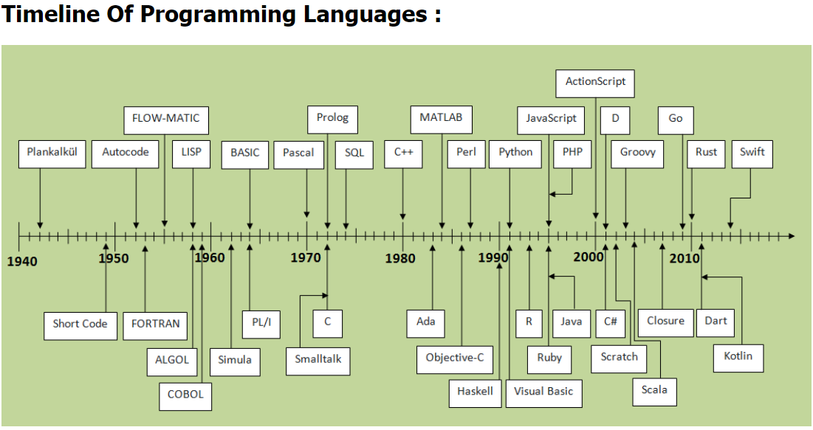
Python was first released in 1991
Source: https://javaconceptoftheday.com/history-of-programming-languages/

Slide 9
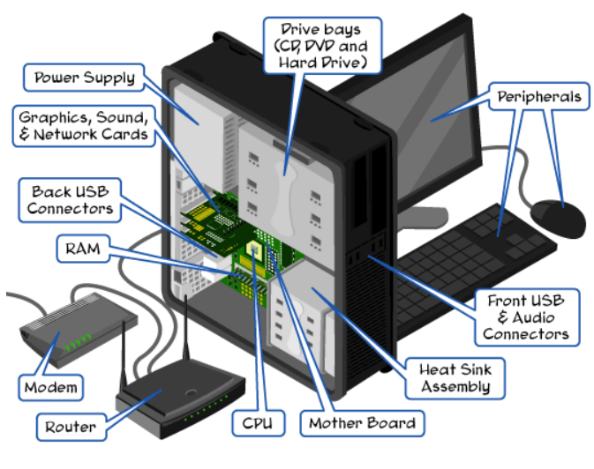
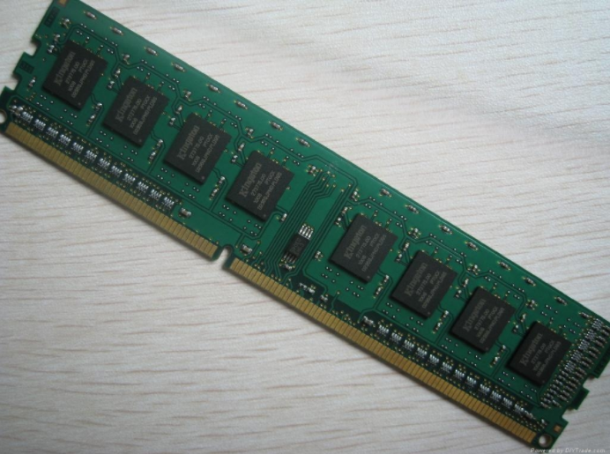
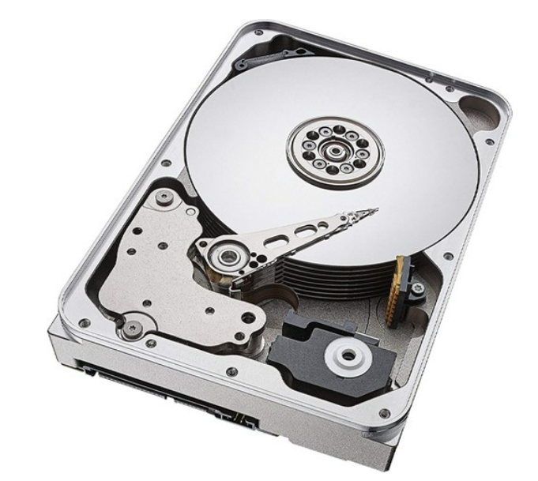
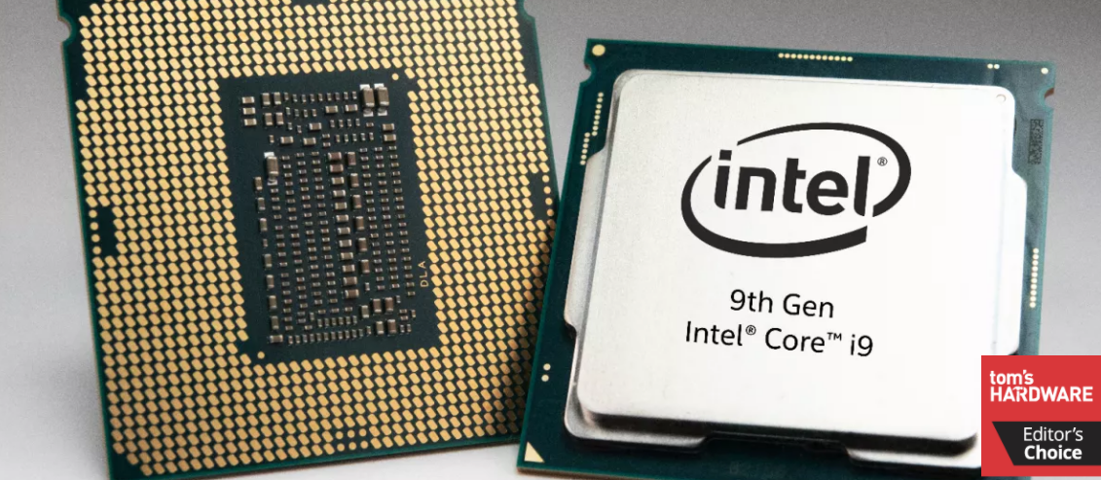
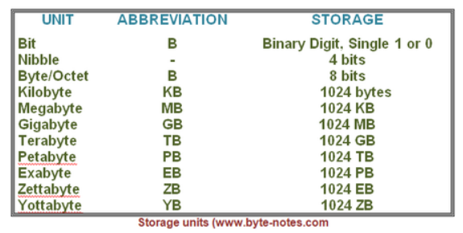
Computer basics
Processor
RAM
Hard disk
CPU (chip)
Data units
Notes:
CPU, Hard
Operating system
Disk partition
Disk space

Slide 10
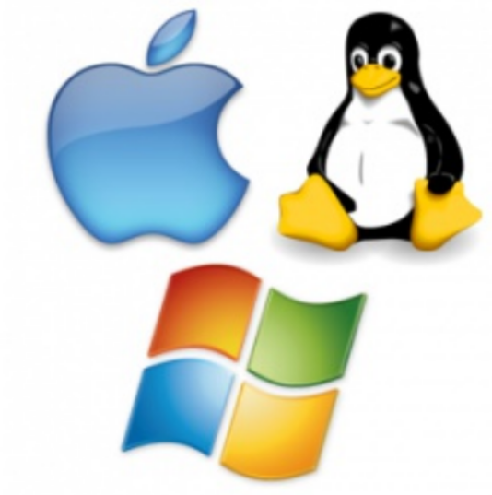
Most popular operating systems
Mac, Linux,
Windows

Slide 11
Communities & learning platforms
Subscribe to get useful updates
Learning resources
Python - Official
Stack overflow - Forum
Medium - Blog
Towardsdatascience - Blog
Tutorialspoint
Geek for geeks
W3schools
Real Python
Programiz
Data competitions
Kaggle
DrivenDate
TopCoder
DataHack

Slide 12
Programming basics

Slide 13
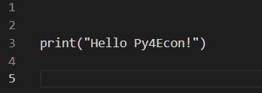
Programming language
A programming language is a formal language comprising a set of strings that produce various kinds of machine code output.
Wikipedia

Slide 14
Must-have basics for a good programmer
Data Structure and Algorithm
A Version Control Tool (Git)
One Text Editors (VScode)
IDEs (Spyder or Pycharm)
Database and SQL
UNIX (Linux)
An OOP Programming language (C++, Java or Python)
One Scripting language (automation)
Networking basics
Cloud Platform (AWS, GCP, or Azure)
Containers (Docker and Kubernetes)
Notes:
https://dev.to/javinpaul/11-essential-skills-software-developers-should-learn-in-2020-1bio

Slide 15
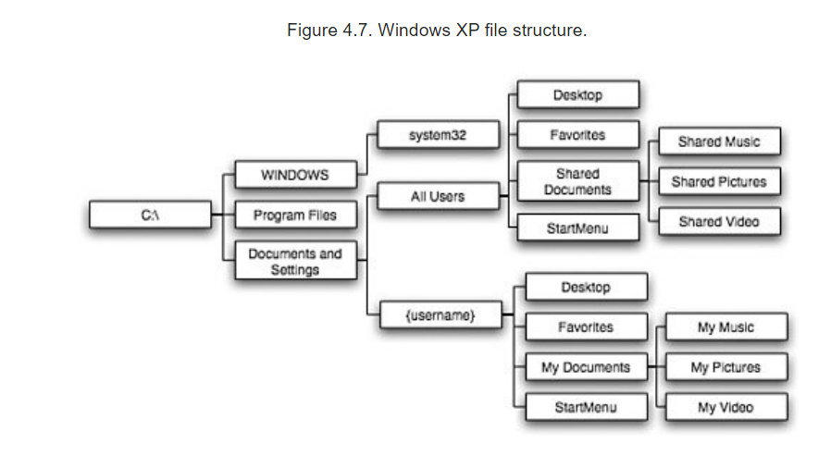
Folder structure
Copy path:
- Ctrl + L = folder path
Shift + Right mouse > copy as path (a) = file path
When naming folder & file:
Avoid spaces and uncommon characters
Use either camel or snake cases
C:\Documents and Settings\sugarkhuu\My Documents\My Video

Slide 16
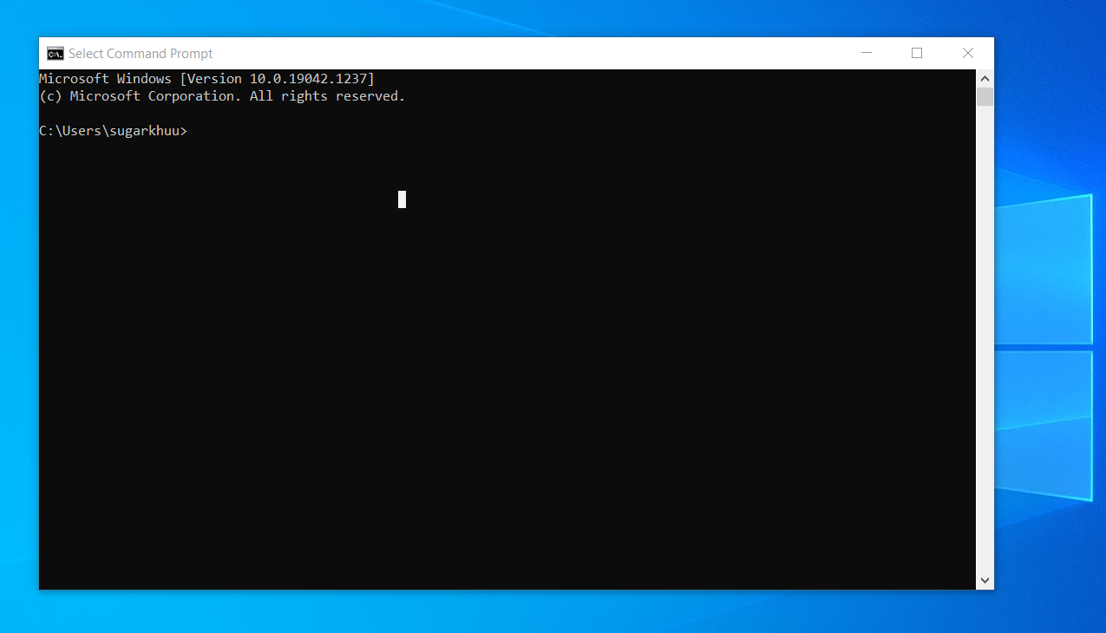
Command line interpreters/Shells
You are able to control your computer through commanding the OS from terminals. More powerful and flexible than usual GUI way of doing things
Windows: Command prompt, Powershell. More recently, Windows Terminal
Linux: Bash
Notes:
https://en.wikipedia.org/wiki/List_of_command-line_interpreters

Slide 17
Common CMD commands
cd – change directory. /? - help
dir – directory content
copy – copy file
ren – rename file
del – delete file
mkdir – create new folder
exit
cls – clear terminal

Slide 18
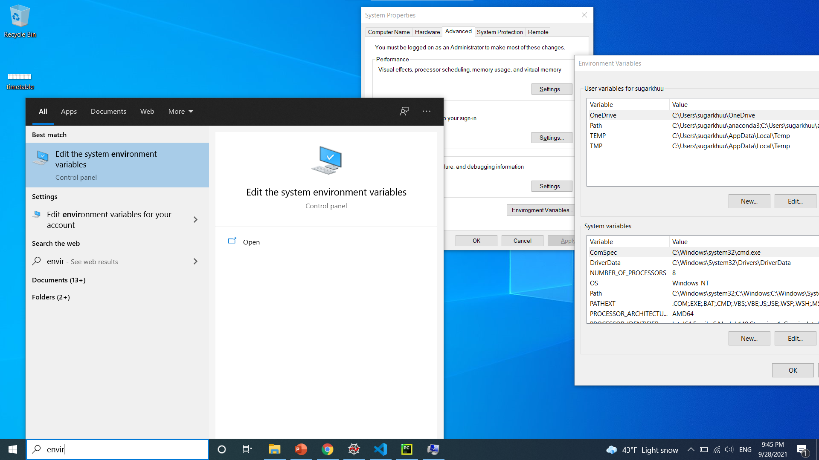
Path (environment variable)
The PATH variable makes it easy to run commonly used programs located in their own folders.
2
3
1

Slide 19
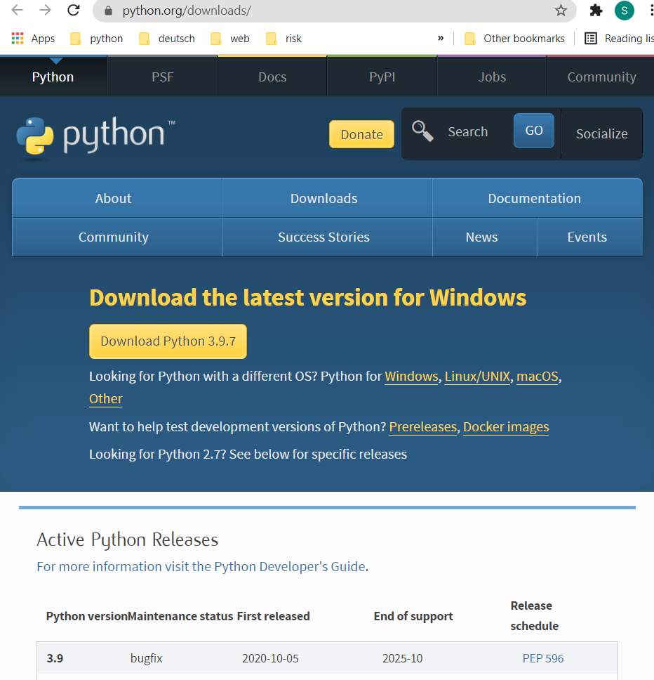
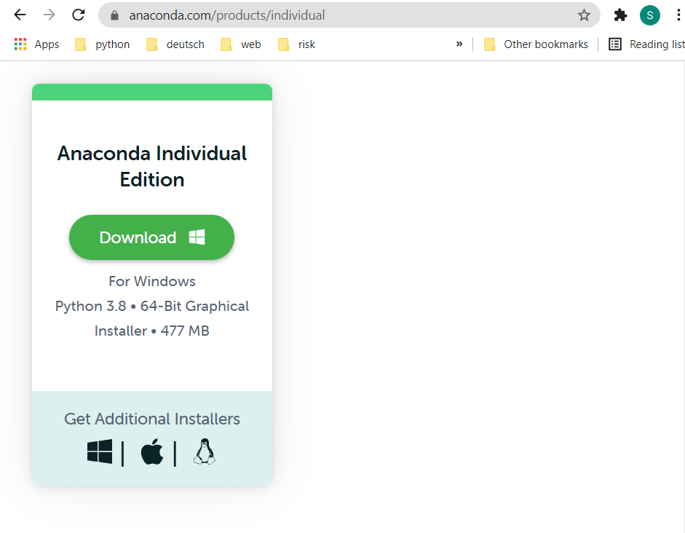
Getting Python
Standalone Python
Anaconda (incl. python)
Pre-installed all packages useful for data science
https://www.python.org/downloads/
https://www.anaconda.com/products/individual,
https://www.datacamp.com/community/tutorials/installing-anaconda-windows

Slide 20
Possible to use Python in many environments
Terminal
IDEs – Spyder or Pycharm (IntelliJ), VScode
Notebook - Jupyter notebook (examples - https://github.com/susanli2016/Machine-Learning-with-Python)
Python basic concepts:
Basic syntax
Basic operators
Packages (+ pip)
Docstring
Read data
Notes:
https://www.datacamp.com/community/tutorials/markdown-in-jupyter-notebook?utm_source=adwords_ppc&utm_campaignid=1455363063&utm_adgroupid=65083631748&utm_device=c&utm_keyword=&utm_matchtype=b&utm_network=g&utm_adpostion=&utm_creative=278443377086&utm_targetid=aud-299261629574:dsa-429603003980&utm_loc_interest_ms=&utm_loc_physical_ms=1010217&gclid=CjwKCAjw49qKBhAoEiwAHQVTo0fumNMyyf-QtaeytZkvwlDCsC1CX7Po-4RFondvppCYpNERwoY7uRoC0IIQAvD_BwE

Slide 21
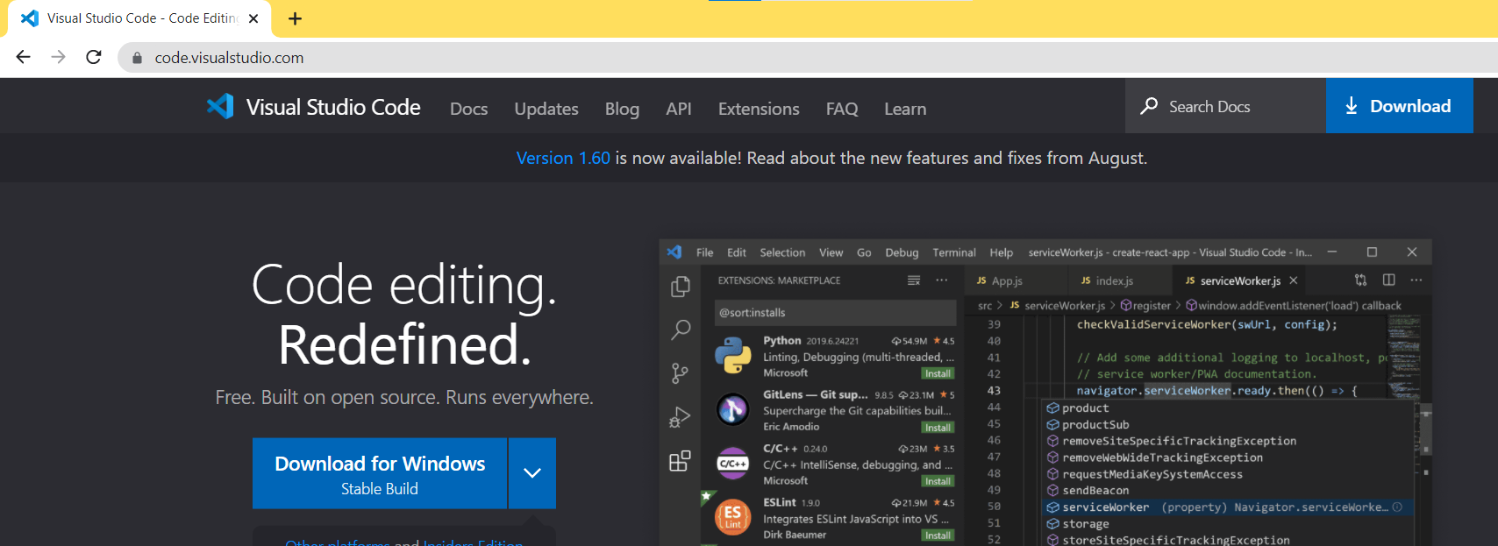
Using VS code (code editor) for Python
Notes:
Python extension
Terminal

Slide 22
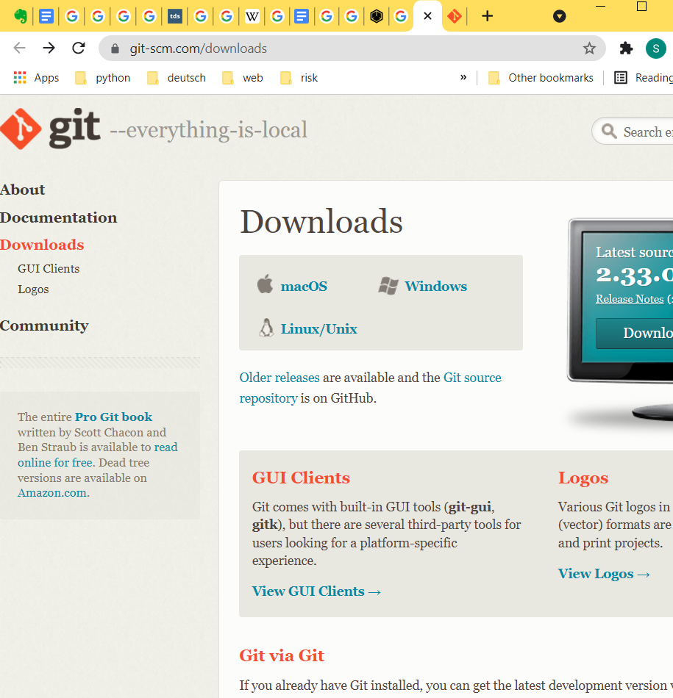
Git – Version control system (VCS)
Version control system (VCS):
Version control systems are a category of software tools that helps in recording changes made to files by keeping a track of modifications done to the code.
https://www.geeksforgeeks.org/version-control-systems/
Popular VCSs: Git, Subversion, Helix core, Microsoft TFS
https://git-scm.com/downloads

Slide 23
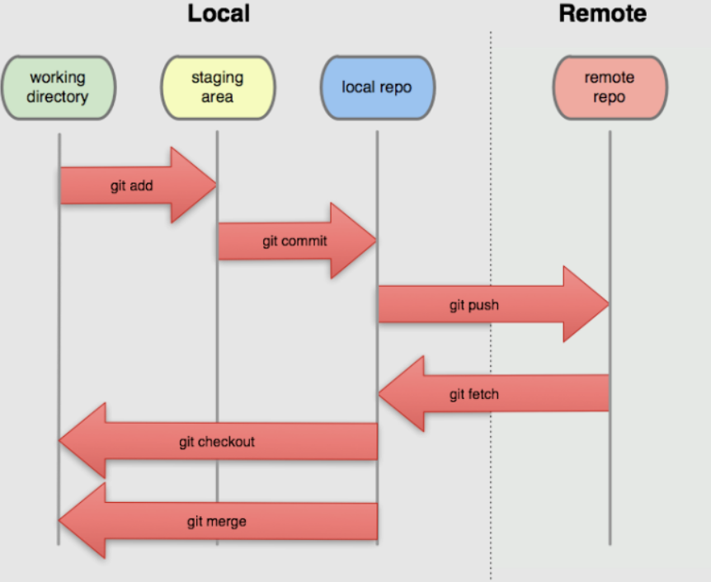
Notes:
Create local repo
Checkout local repo
Create file and commit
Edit files and commit
Checkout, create, merge branches
Vscode extension
Show git structure in Pycharm and VScode
https://stackoverflow.com/questions/13072111/gits-local-repository-and-remote-repository-confusing-concepts

Slide 24
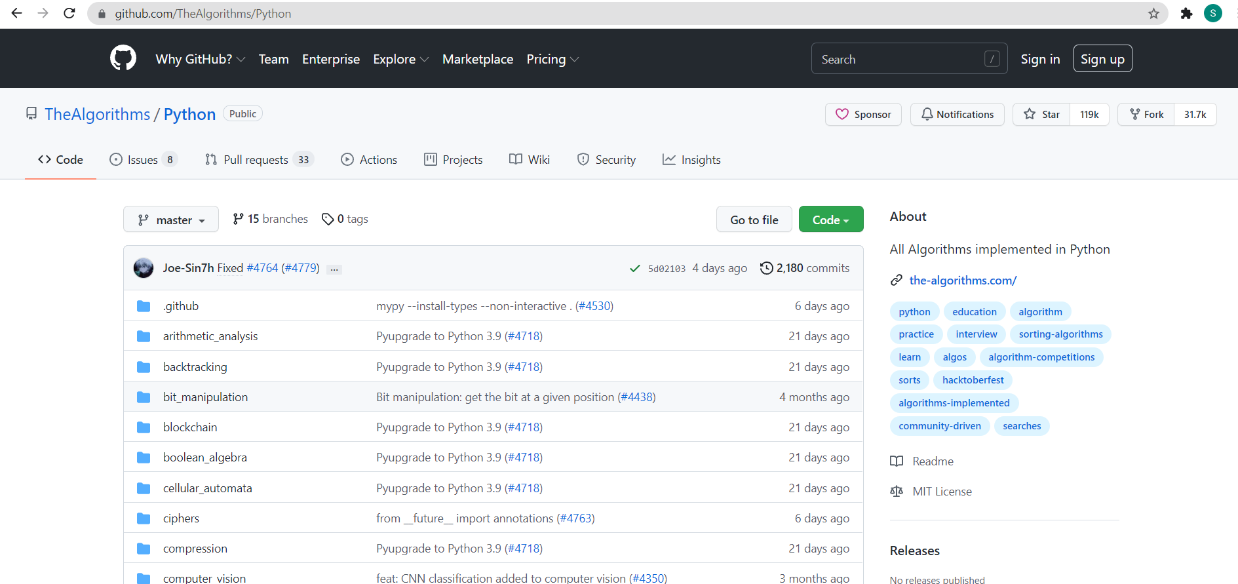
Github – Share everything you want
https://code.visualstudio.com/
Notes:
Create repo on github and clone
Create local repo and connect
Push without credentials – use git bash

Slide 25
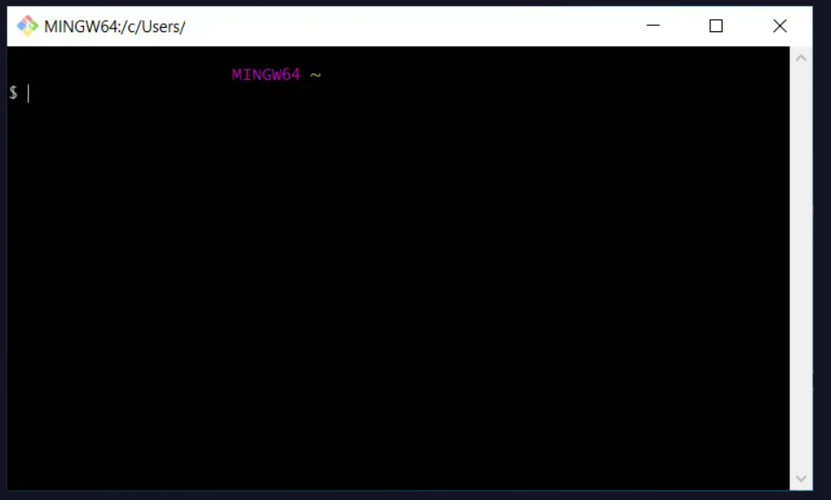
Git bash (unix based commands on Windows - Emulator)
Linux CLI is powerful
Common Linux Commands
https://www.dummies.com/computers/operating-systems/linux/common-linux-commands/

Slide 26
Coding best practices
Description of the code
Comments
Simple and short variable name (convention)
Indentation
Commit little by little
Logically consistent and well tested …
Notes:
https://en.wikipedia.org/wiki/C
https://betterprogramming.pub/good-code-vs-bad-code-35624b4e91bcoding_best_practices

Slide 27
Homework Deadline: 13 Nov, 2021

Slide 28
Task 1
Create a new repository in your Github
Clone the previous repository to your local machine
Create a Jupyter notebook in the local repo (in your folder). In the notebook, write a code which asks 5 separate questions and receives the answers from the user (we had an example with only one question in the lecture). Commit and push your changes question by question
Make sure your code follows the good practice

Slide 29
Task 2
Нэг компьютерт хоёр үйлдлийн систем суулгаж болох уу?
Path-д программаа оруулаагүй бол яах вэ?
Фолдерийн нэр нь дундаа зайтай байвал фолдерийг танихад ямар асуудал үүсэх вэ?
Git, Github хоёрын ялгаа юу вэ?
Jupyter notebook IDE мөн үү?
Commit, push хоёрын ялгаа юу вэ?
Push хийхээс өмнө олон дахин commit хийж болох уу?
Commit хийхэд github repo-д access хэрэгтэй юу?

